Slide 1
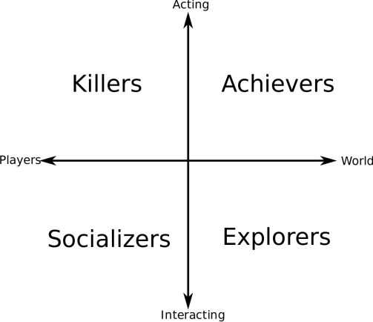

Name
Age
Employment
Personality keywords
Biog
Goals
Personal motivations
Social motivations
Financial motivations
Image
We must:
We must not:
Phone
Tablet
Laptop
Desktop
Social net

